Slide 1
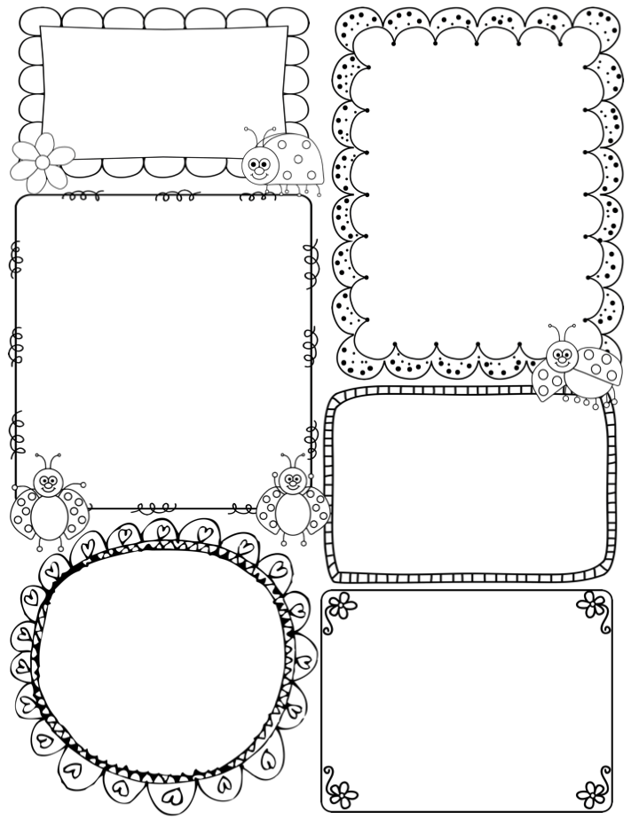
October 1
Welcome Back!
I hope everyone had a wonderful and relaxing fall break!
Phonics:
We will learn how to form and recognize uppercase and lowercase letters k-z. We will also continue to identify rhyming words and practice segmenting words. Continue to practice snap words on List 1! Thank you for spending time with your child on the homework packets!
Reading:
We will be reading books and identifying the main ideas as well as learn how to sequence and retell a story so that it makes sense! We will also analyze main characters. Remember to read to your child daily!
Writing:
We will continue telling, drawing, and writing narrative stories. We will work on having a beginning, a middle, and an ending.
We will have early release the week of Oct. 15-19.
Conference forms will come home in your child's folder. Please confirm time,
sign and return.
Thank you!
Math:
We will continue counting to 50, counting objects to 10, and identifying and comparing 2 dimensional and 3 dimensional shapes.

